Slide 1
PENN COMMUNITY SCHOLARS
DATA
ANALYTICS 101
March 9, 2023
How to leverage data to foster successful community-academic partnerships

Slide 2
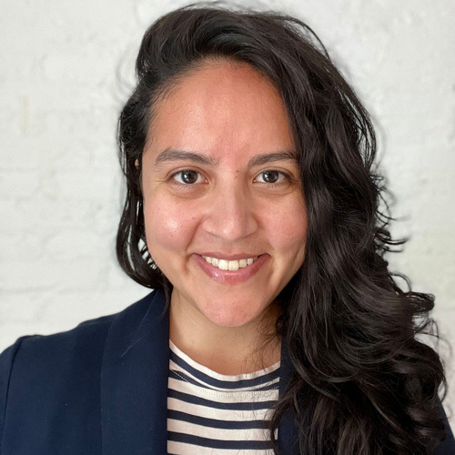

THE URBAN HEALTH LAB DATA TEAM
Silvia Canelón, PhD
Emily Seeburger, MPH

Slide 3
TODAY’S AGENDA
Introduction
Ways to use data
Incorporating principles of equity in data
Data for Community-Academic Collaboratives
Highlighting the Urban Health Lab's Deeply Rooted project
Demonstration
Highlighting the disproportionate impact of gun violence
Free resources
Questions

Slide 4
HOW DO YOU MAKE YOUR MISSION STAND OUT?
8,000+
Number of registered nonprofit organizations in Philadelphia

Slide 5
GOOD DATA!

Slide 6
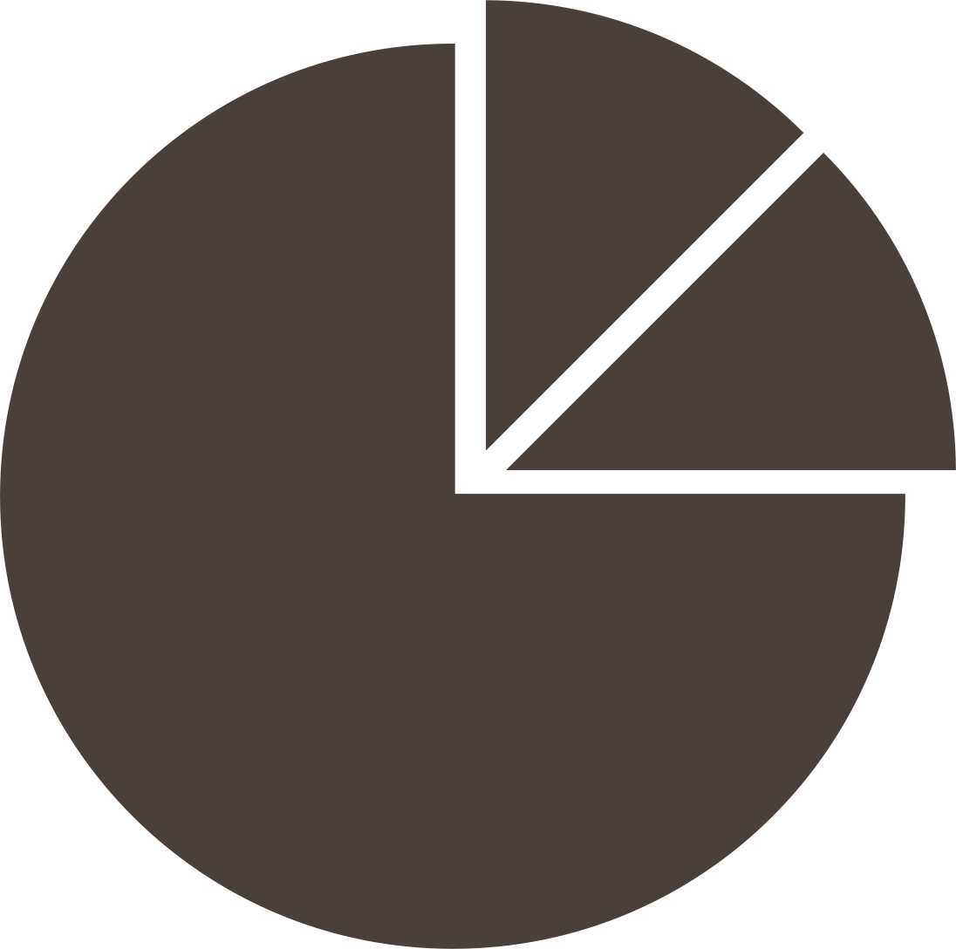


WAYS TO USE DATA
Summary Stats
Describing basic information about your data
Communicating Impact
Highlighting outcomes related to a program or policy
Community Engagement & Storytelling
Generating ideas and conversations

Slide 7
DATA EQUITY PRINCIPLES
Critically examine the data
Consider who is included and excluded from the data, how these data were collected, why they were collected, and who benefits or is harmed by them
Consider language
Consider the words, phrases, and labels that are used
to describe people, groups, and communities, and
to frame the larger picture and context of the data
Adapted from
the Urban Institute
Do No Harm Guides
urbn.is/donoharm
Consider colors
Consider colors that are accessible for people with different abilities, and avoid reinforcing racial or gender stereotypes
Consider icons & shapes
Consider icons and shapes that show people as empowered and dignified, and avoid reinforcing harmful or offensive stereotypes

Slide 8
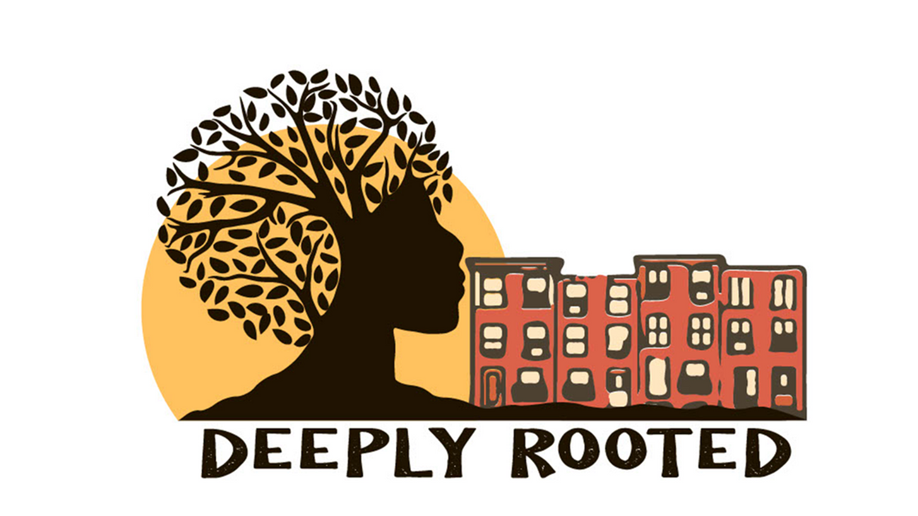
Deeply Rooted

Slide 9
Deeply Rooted overview
Data for Community-Academic Collaboratives:
Penn Urban Health Lab's Deeply Rooted
About
Goals
Leverages the healing power of nature to improve health using placed-based interventions in partnership with communities.
$6 million investment by Penn Medicine and the Children's Hospital of Philadelphia
Partner with 15-20 community and faith-based organizations
Award 100 Community Green Grants
Plant 1500 trees
Green and maintain 1 million sq. ft. of vacant land
Co-design and create 6-8 mini-parks
Youth engagement
Workforce development
Environmental justice
Community
Four initial target neighborhoods in West/Southwest Philadelphia
Pennsylvania Horticultural Society serves as our strategic greenspace implementation partner

Slide 10
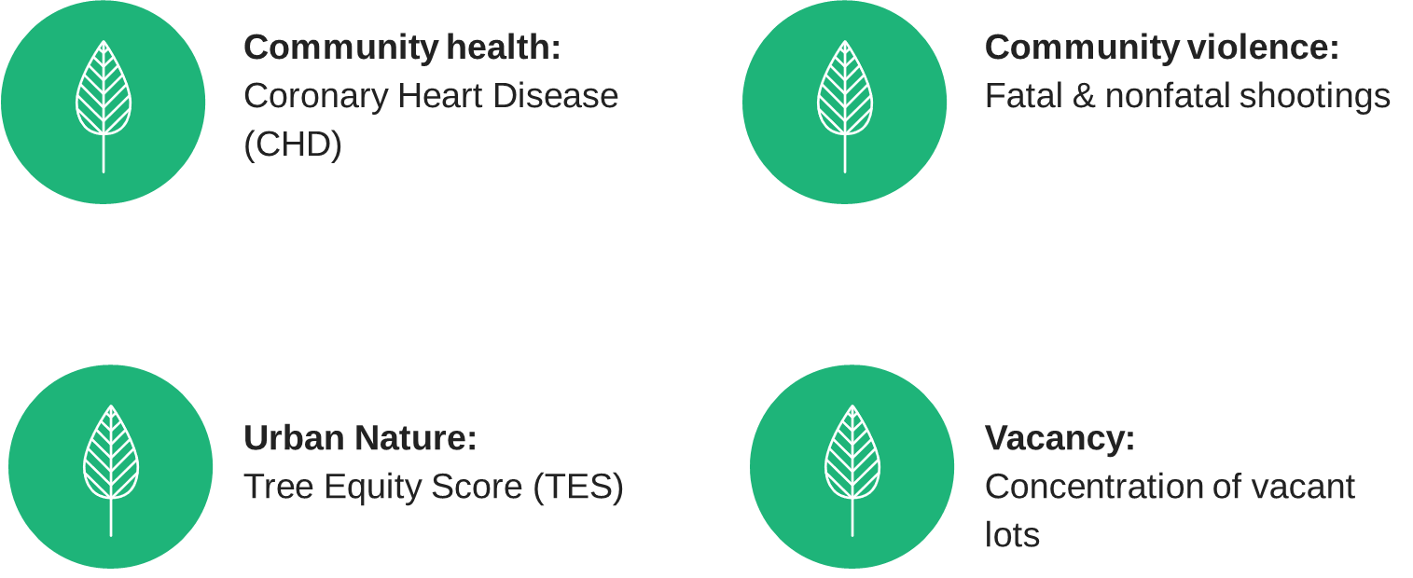
Deeply Rooted metrics
Data for Community-Academic Collaboratives:
Penn Urban Health Lab's Deeply Rooted

Slide 11
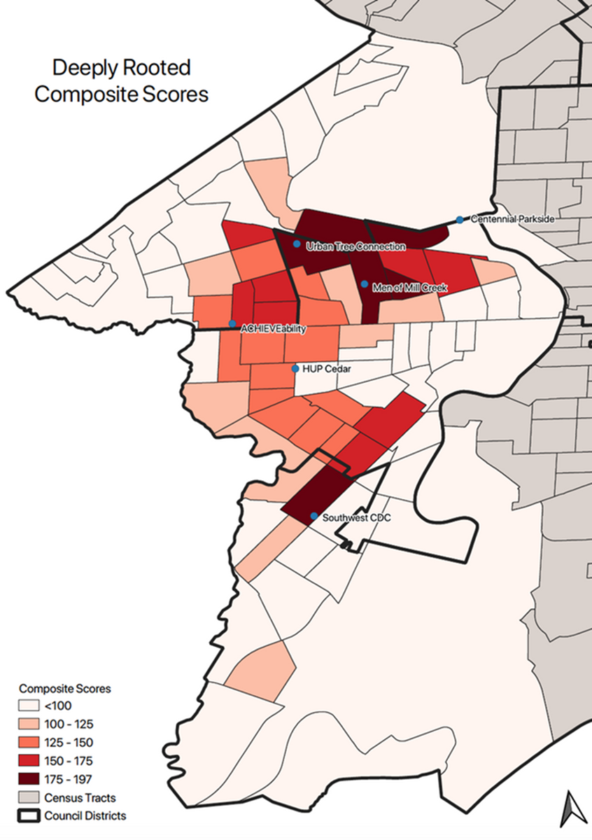
Map of Deeply Rooted Composite Scores

Slide 12
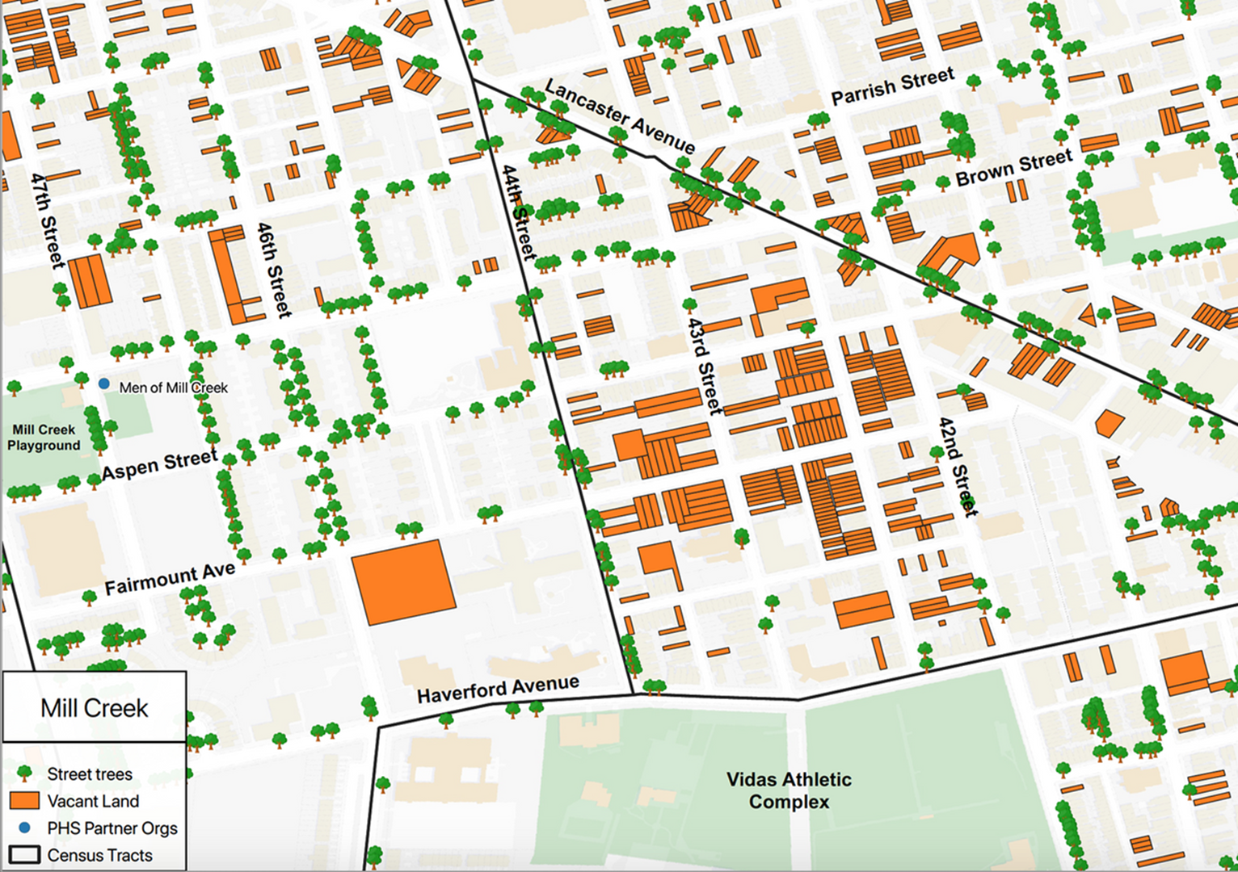
Map of Mill Creek

Slide 13
DEMO

Slide 14
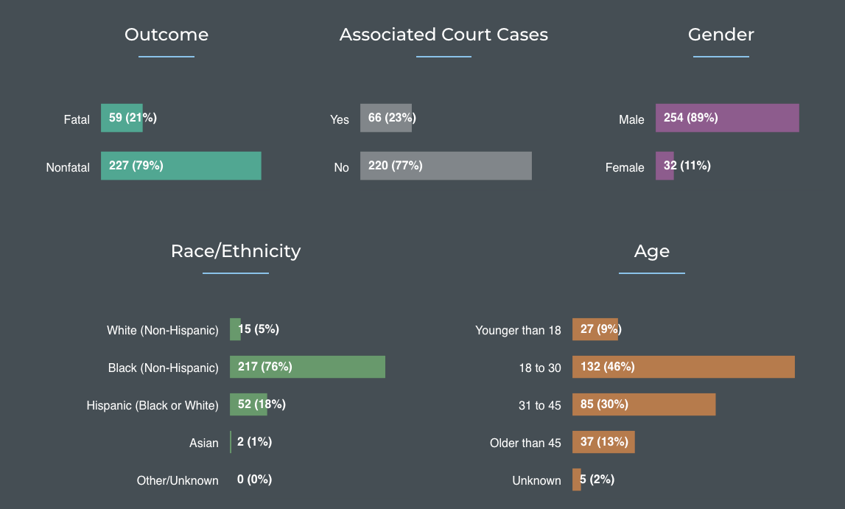
Interactive: Mapping Philadelphia's Gun Crisis (as of March 7, 2023)

Slide 15



Creating some data summaries using data on victims of gun violence
Sourcing the data
DEMO
Dataset on city-wide victims of gun violence
https://opendataphilly.org/dataset/shooting-victims
Download as a CSV
Summarizing the data
Create pivot table in MS Excel
Add year and fatal variables to Filters (filter to 2023)
Add race and latino variables to Rows
Add sex variable to Columns
Add race variable to Values: Count of race
Customize labels along the way using metadata
Visualizing the data
Insert pivot chart
Change chart to horizontal bar chart
Add data labels

Slide 16
Open data & free software resources
Open Data
OpenDataPhilly
US Census Bureau
Data Visualization
Canva
Carto
Datawrapper
Tableau Public
FREE RESOURCES
Software
QGIS
R & RStudio Desktop

Slide 17
Free data communication resources
Data Equity
Applying Equity Awareness in Data Visualization
Diversity, Equity, and Inclusion in Data Visualization: General Recommendations
Racial Equity in Data Visualization Checklist
Centering Accessibility in Data Visualization
FREE RESOURCES

Slide 18
QUESTIONS?

Slide 19
CONTACT US
Penn Urban Health Lab
urbanhealthlab.org
emily.seeburger@pennmedicine.upenn.edu
silvia.canelon@pennmedicine.upenn.edu
silviacanelon.com

